Slide 1
Dynamic Resource Allocation
Jon Rogers
Kyle Volle
4/16/14

Slide 2
As a Markov Decision Process
Currently treated as a deterministic system
Currently treated as fully observable
Negative reward for state differing from goal
Under and over targeting treated the same
Reward function can be varied
Simplifying assumptions reduce state space

Slide 3
Markov Decision Process (Cont.)
Agent state is expressed as a vector
First element is agent’s target
Rest of elements are totals for each target
Reward function is based on total error
R(s) = Σ |s_{i+1} – target_size_{i}|
Future iterations might incorporate distance

Slide 4
Time to Convergence
Robots | Targets | States | Time (s)
6 | 2 | 12 | 0.195
9 | 3 | 135 | 0.153
12 | 4 | 1,456 | 2.177
15 | 5 | 15,300 | 127.4
Tested with uniform target sizes
Uses modified policy iteration
Initialized with random policy

Slide 5
Decentralized Clustering
Clustering algorithms focus on the targets
Each target is assigned the closest vehicles
Decentralized versions are probabilistic
Agents abandon over-targeted targets
Probability depends on distance and targeting
Converge to best solution if given enough time
A Method for Decentralized Clustering in Large Multi-Agent Systems. Ogston, Elth et al

Slide 6
Decentralized Clustering (Cont.)
Agents communicate their targets
Agents also know their distance to each target
Redundant agents have a chance of switching
P_{switch}(agent) = (number_targeting-target_size)/(2*target_size)
If agent switches, randomly selects new target
Probability density function is inverse of distance
These probabilities can act as tuning parameters to improve performance

Slide 7
Clustering Example
Target | Robots Assigned | Robots Required | Distance from Agent 1
Target A | 5 | 3 | 10 units
Target B | 1 | 3 | 15 units
Target C | 2 | 3 | 30 units
Agent 1 is currently assigned to Target A
P_{switch}= (5-3)/(2*3) = 0.33
Assuming it switches, randomly select new target
PDF = α[0, 1/15, 1/30] (α is a normalizing constant)

Slide 8
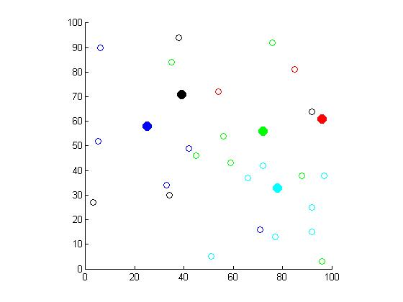
Example of Clustering Method
Visualization of Simulated Scenario
Filled circles represent targets
Empty circles represent vehicles

Slide 9
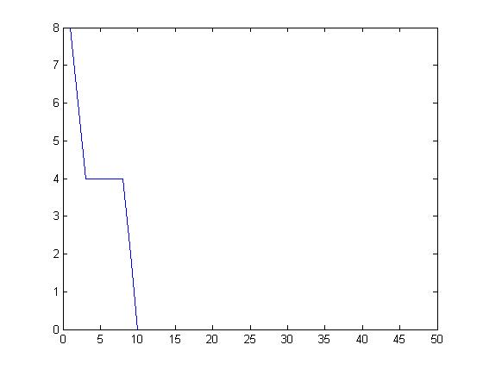
Example of Clustering Method
Performance of Clustering
Absolute Error
Iterations

Slide 10
Method Comparison
MDP
Generates human readable policy
Makes explicable decisions
Guaranteed optimality
Decentralized Clustering
Requires no pre-planning time
Incorporates physical distance as a metric
Probabilistic guarantee of success

